Slide 1
GTCMHIC ORIENTATION
New Director Orientation
Greater Tompkins County Municipal Health Insurance Consortium
March 22, 2018

Slide 2
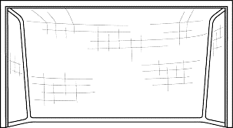
Goal/Agenda of Orientation
What is Health Insurance?
How does the insurance system work?
Why do Health Insurance costs rise so fast?
What is Article 47?
How was the GTCMHIC created?
Organization structure
How has the GTCMHIC grown?
Annual Budget
Benefit Plans and Actuarial Value
Board Agenda

Slide 3
Health Care is a Business
Patients purchase health care products and/or services from private sector providers and/or facilities.
In 2017, health care spending in the United States of America accounted for approximately 18.3% of the Gross Domestic Product (GDP).
Medical care spending is a major component of our GDP which is growing faster than other CPI tracked goods and services.

Slide 4
Subscriber Share of Costs
Deductibles
Coinsurance Amounts (e.g., 20%)
Copayment Amounts (e.g., $15.00)
Out-of-Network Provider Balance Bills
Non-Covered Products or Services

Slide 5
Why Have Health Insurance Costs Increased Faster than CPI
Health Insurance cost increases are a function of many factors including, but not limited to:
Medical Care Inflation
Advancements in Medical Technology
Advancements in Pharmaceuticals
Federal and State Mandated Benefits
Decrease in the “Value” of Cost Sharing Items
Federal and State Taxes and Fees
Medical Malpractice Costs (Insurance & Litigation)

Slide 6
Health Insurance Why Do We Need It?
Illness, Disease, and Injury are Unpredictable Events.
The Cost of Services can be Exorbitant.
Approximately 20% of the Population Accounts for 80% of health insurance claims.
Pooling Risk Protects Individuals and Employers from Financial Catastrophe.

Slide 7
What is Health Insurance
Health Insurance is an agreement (benefit plan) whereby monthly premiums are paid to an insurance company which promises to cover all or a portion of medical (health care) services/procedures, materials (prescription) costs (benefits).
The amount of the premiums vary with the level of benefits.
The cost of medical services typically increases with age, yet premiums stay are the same over the population. This is the foundation of health insurance. By pooling risks we financially support a system that provides security for those tikes we need health care.

Slide 8
Sample Excellus BCBS Client
Incurred between January 1, 2012 and December 31, 2012, paid through March 31, 2013
High Cost Claimant Costs by Member (>= $25,000)
 |  | High Cost Claimants by Most Costly Diagnosis | Prior Plan Cost | Current Plan Cost | UM | CM | DM | Rx Sp CM
1 |  | 196 Secondary and Unspecified Malignant Neoplasm of Lymph N | $335,633 | $1,063,623 | YES | YES | NA | NA
2 |  | 238 Neoplasm of Uncertain Behavior of Other and Unspecified | $13,124 | $441,920 | NA | NA | NA | NA
3 |  | 227 Benign Neoplasm of Other Endocrine Glands and Related S | $103,889 | $393,046 | YES | YES | YES | NA
4 |  | 572 Liver Abscess and Sequelae of Chronic Liver Disease | $47,576 | $260,259 | YES | NA | YES | NA
5 |  | 162 Malignant Neoplasm of Trachea, Bronchus, and Lung | $52,141 | $191,355 | NO | NO | NO | NA
6 |  | 724 Other and Unspecified Disorders of Back | $9,684 | $174,144 | YES | NA | YES | NA
7 |  | 733 Other Disorders of Bone and Cartilage | $73,675 | $133,579 | YES | YES | NA | NA
8 |  | 99681 Complications of Transplanted Kidney | $6,074 | $121,509 | YES | YES | YES | NA
9 |  | 562 Diverticula of Intestine | $1,855 | $119,026 | NA | NA | NA | NA
10 |  | V5811 Encounter for antineoplastic chemotherapy | $295,897 | $114,362 | YES | NA | NA | NA
11 |  | 189 Malignant Neoplasm of Kidney and Other and Unspecified | $16,753 | $104,522 | YES | YES | NA | NA
12 |  | 715 Osteoarthrosis and Allied Disorders | $23,273 | $104,433 | YES | NA | YES | NA
13 |  | 753 Congenital Anomalies of Urinary System | $14,937 | $102,991 | YES | NA | NA | NA
14 |  | 153 Malignant Neoplasm of Colon | $2,451 | $100,764 | NA | NA | NA | NA
15 |  | 536 Disorders of Function of Stomach | $8,254 | $99,967 | YES | NA | NA | NA
16 |  | 491 Chronic Bronchitis | $19,091 | $97,636 | YES | NA | YES | NA
17 |  | 428 Heart Failure | $129,961 | $92,629 | YES | NA | NA | NA
18 |  | 99666 Infection and Inflammatory Reaction Due to Internal Joi | $26,714 | $89,488 | YES | NA | YES | NA
19 |  | 237 Neoplasm of Uncertain Behavior of Endocrine Glands and | $0 | $88,683 | NA | NA | YES | NA
14 People Exceeded $100,000 in Medical Paid Claims in 2012 for a Total Spend of $3,425,533
UM - Utilization Management, CM - Case Management, DM - Disease Management, Rx Sp CM - Pharmacy Benefit Specialty Drug CM

Slide 9
Risk vs Premium
For Employer and Employee
Self-Insured Plans
Community Rated Plans
Experience Rated Plans
Minimum Premium
Retrospective Rating
Prospective Rating
100% Risk
Lowest Cost
0% Risk
Highest Cost

Slide 10
What is Article 47?
Article 47’s are self-insured insurance companies created by NYS.
Write benefit plans, collect premium, assume 100% of liability
Allows Municipalities regardless of size to Pool health insurance risk as one community.
Regulatory Requirements Include, But are not Limited to:
Adoption of a Municipal Cooperative Agreement
Funding 2 Statutory Reserves (Surplus-5% premium & IBNR-12% of claims)
Creating a Role for Labor in the Governance Structure
Joint Committee on Plan Structure and Design
Voting Seats on the GTCMHIC Board of Directors
NYS DFS Reporting and Oversight
GTCMHIC Certificate of Authority was Issued on 10/01/2010
GTCMHIC Operations Began on 01/01/2011

Slide 11
Advantages for Small Employers
Part of large self-funded risk pool that is rated as one Community.
Co-Owner
Asset growth with Fund Balance
Manage benefit level of plans
Establish premium rates
No broker fee (4% of premium)
No PPACA Insurance Fee (3% of premium)
Notes:
Art 47 advantages are the opportunity for small employers to receive the lower premiums that self-insuring offers.
Also muni become owners which means assets of the Consortium accrue on a prorata basis the town.
Art 47 are structurally more efficient that either self-insured and CR models because there is no broker fee saving 4% and the Consortium is not required to pay the 3% ACA Insurers fee.
Art 47 with labor rep have advocates for rank subscribers in decision making roles.
GTC contracts with Excellus and large 3rd party admin to receive the benefit of their large provide network and lower negotiated service fees

Slide 12
Consortium Overview Starting the Consortium Concept
In 2007, TCCOG was awarded a Shared Municipal Services Incentive (SMSI) grant of nearly $250,000 to assist in the development, approval, and implementation of the GTCMHIC.
Article 47 of the New York State Insurance Law allowed all municipalities to belong to the GTCMHIC with an estimated savings >$900K
Not one Article 47 Municipal Cooperative Health Benefits Plan had been created since the legislation passed in 1992.

Slide 13
Creating the Consortium
Creating a governance structure balance between large municipalities like Tompkins County with over 1,200 employees with small towns and villages with less than 10 employees.
In 2009, the framework of the GTCMHIC was formed and the Municipal Cooperative Agreement (MCA) was signed by all 13 participating municipalities. Then GTCMHIC submitted its application to the NYS Ins. Dept. and soon discovered that the hardest work was still to come.
One task was to create a meaningful role for labor within the Consortium’s decision making process. Joint Committees on benefit plan design had been proposed. However, NYSID’s reading of Article 47 required Labor to have voting seats on the Board.

Slide 14
Final Steps for Consortium
The 13 Participating Municipalities collectively funded $1.22M Surplus Reserve from fund balances to satisfy the capital surplus requirements of Article 47. To meet this requirement, capitalization was not done by prorata shares. These funds were paid back at end of year 3.
We negotiated the IBNR reserve to equal 12% of the incurred claims for the year. This was one half of the statutory requirement of 25% and 5% less than the reserves proposed by the NYSID.
GTCMHIC was awarded a Certificate of Authority on October 1, 2010

Slide 15
Employee/Retiree Protections
Consortium, not a third party insurer controls Benefits and Rights Protected by Collective Bargaining Agreements / Personnel Policies
New York State Department of Financial Services provides oversight to ensure adequate funds are available for all liabilities.
Labor has Representation in the Process
Consortium maintains commitment toTransparency of Information and Results

Slide 16
The Municipal Cooperative Agreement
The MCA is an agreement between municipal owners of an Insurance Company that writes benefit plans which must be approved by the NYS Dept. of Financial Services.
The MCA provides the operational framework of the GTCMHIC by:
Affirming the shared fiscal responsibility for covering all eligible incurred claims. Each municipalities financial stake is based on total premiums contributed;
Establishes the Board of Directors which consists of one representative for each municipal member and a number of labor representatives who each have equal voting power. However, weighted voting can be invoked in certain instances, but has not been to date;
Stipulating that the Board is responsible to direct & protect the Consortium;
Creating the Joint Committee on Plan Structure and Design
Describing how municipalities may join the Consortium, leave the Consortium, or how the Consortium could be dissolved.

Slide 17
How is the MCA Organized
Sections A&B describe Participants and their responsibilities
Sections C-H describe the Board of Directors, their operating procedures, and responsibilities
Section I describes the Plan Administrator
Section J describes the function of the Chief Financial Officer
Section K describes the Joint Committee on Plan Structure and Design
Sections L-N describe Premiums
Sections O-X describe processes for Participants to work with each other for items like changes to MCA, joining, leaving, dissolution, and disputes, etc.

Slide 18
Orientation Manual
MCA
Organization Chart
Board of Directors
Policies
Committees
Benefit Plan Menu
Claims Administrators- Excellus and ProAct
Appeals process
Website
Annual Report

Slide 20
Role of the Directors
Directors are appointed by municipality. Not required to be an elected official or staff.
Responsible for providing Direction and Protection of Consortium
Responsible to become informed of decisions before the Board
Attend 5 Board meeting per year
May share responsibility with Alternate Director
Stay informed of Committee work and serve if possible
Communicate Consortium actions to Municipality

Slide 21
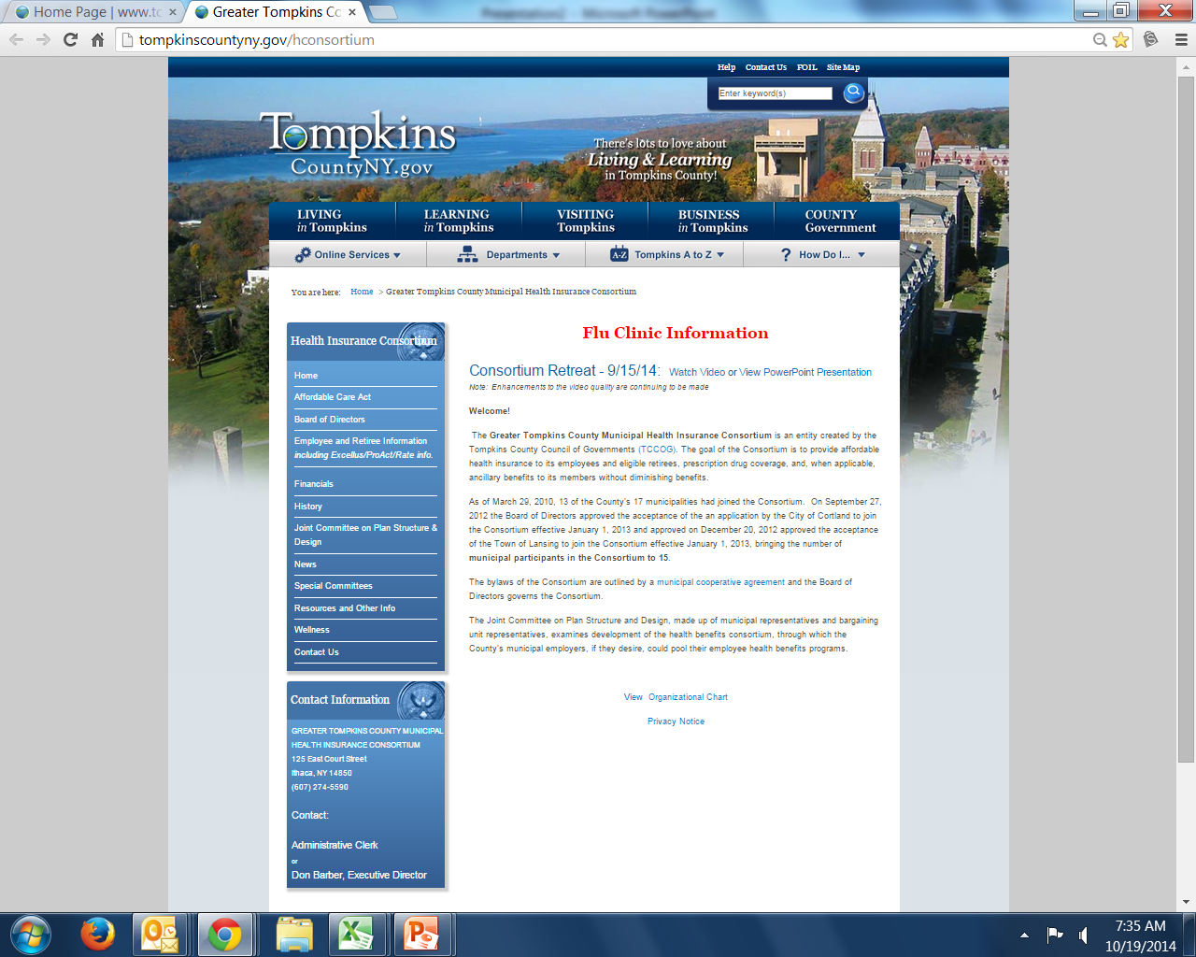
www.tompkinscounyny.gov/hconsortium

Slide 22
Board of Directors

Slide 23
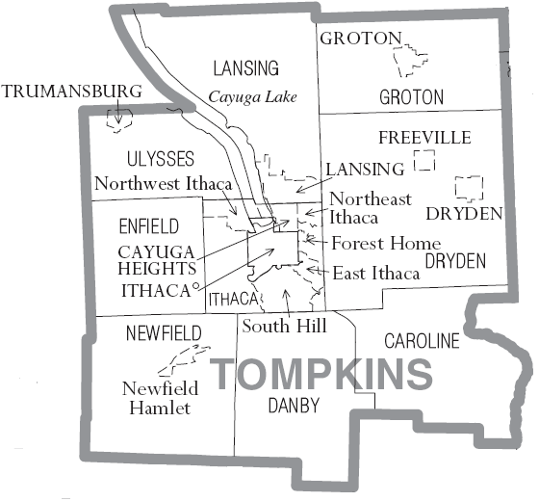
Who is in the Consortium?
Consortium membership was initially offered to each municipality within the geographical boundaries of Tompkins County which included the County, City of Ithaca, and thirteen Towns and Villages.
2015 MCA expanded to any municipality in Tompkins County and the Counties contiguous to Tompkins County which includes any municipality in Cayuga, Chemung, Cortland, Schuyler, Seneca, and Tioga Counties.

Slide 24
GTCMHIC Update
Our List of Municipal Partners
City of Cortland
City of Ithaca
County of Tompkins
Town of Aurelius
Town of Cincinnatus
Town of Caroline
Town of Danby
Town of Dryden
Town of Enfield
Town of Groton
Town of Ithaca
Town of Lansing
Town of Marathon
Town of Moravia Town of Homer
Town of Montezuma
Town of Newfield Town of Owasco Town of Preble
Town of Scipio
Town of Springport
Town of Truxton
Town of Ulysses
Town of Virgil
Town of Willett
Village of Cayuga Heights
Village of Dryden
Village of Groton
Village of Homer
Village of Trumansburg
Village of Union Springs

Slide 25
GTCMHIC Performance & Growth History from 2011 - 2017
Number of Partners: 13 – 31
Number of contracts: 2000- 2400
Net worth: $1.22 M - $25.2M
Annual Premiums: $25.8M - $40.8M

Slide 26
Millions |  | 2011 | 2012 | 2013 | 2014 | 2015 | 2016 | 2017
 |  | Fiscal Year | Fiscal Year | Fiscal Year | Fiscal Year | Fiscal Year | Fiscal Year | Fiscal Year
Income
Premiums |  | $25.8 | $28.6 | $34.5 | $36.0 | $37.6 | $38.5 | $40.8
Total Income |  | $26.0 | $28.7 | $34.6 | $36.2 | $37.7 | $39.6 | $42.2
Expenses
Claims Expense |  | $25.1 | $24.8 | $28.0 | $29.8 | $28.8 | $35.7 | $37.4
Admin Fees |  | $0.8 | $0.9 | $0.9 | $1.0 | $1.0 | $1.0 | $1.1
Other Expenses |  | $0.4 | $0.4 | $0.6 | $0.6 | $0.6 | $0.6 | $0.6
Stop-Loss Ins |  | ($2.0) | ($0.6) | $0.3 | $0.8 | $0.7 | $0.2 | $0.0
Total Expenses |  | $26.2 | $25.5 | $29.9 | $3.2 | $31.1 | $38.3 | $40.0
Net Income |  | $0.5 | $3.3 | $4.8 | $4.1 | $6.7 | $1.3 | $2.1
Total Assets |  | $4.3 | $7.7 | $11.1 | $15.4 | $22.2 | $22.7 | $25.2
 |  | 2011 | 2012 | 2013 | 2014 | 2015 | 2016 | 2017
 |  | Fiscal Year | Fiscal Year | Fiscal Year | Fiscal Year | Fiscal Year | Fiscal Year | Fiscal Year
Income
Premiums |  | $25,794,917 | $28,575,531 | $34,507,670 | $36,063,291 | $37,587,353 | $38,519,955 | $40,775,535
Total Income |  | $25,968,215 | $28,688,765 | $34,664,104 | $36,210,591 | $37,729,402 | $39,625,562 | $42,160,389
Expenses
Claims Expense |  | $25,136,185 | $24,799,035 | $28,013,757 | $29,755,490 | $28,750,405 | $35,709,322 | $37,456,339
Admin Fees |  | $841,543 | $928,502 | $939,946 | $988,796 | $1,003,466 | $1,040,322 | $1,099,151
Other Expenses |  | $353,292 | $373,096 | $610,890 | $562,919 | $610,589 | $610,589 | $610,589
Stop-Loss Ins |  | ($170,613) | ($590,041) | $310,713 | $836,935 | $706,517 | $242,574 | $431
Total Expenses |  | $26,160,407 | $25,510,592 | $29,875,306 | $32,144,140 | $31,070,977 | $38,364,129 | $40,025,733
Net Income |  | $525,808 | $3,258,773 | $4,788,798 | $4,066,451 | $6,658,425 | $1,261,433 | $2,134,655
Total Assets |  | $4,320,054 | $7,708,613 | $11,135,054 | $15,443,004 | $22,153,922 | $22,691,288 | $25,184,540

Slide 27
Greater Tompkins County Municipal Health Insurance Consortium
GTCMHIC Budget Income % Increase and Excellus Small Group PPO % Rate Increase
Fiscal Year | Budget Income % Increase (2018-2019 Projected) | Excellus BCBS Small Group Rates % Increase *
2011 | 9.50% | 10.00%
2012 | 9.50% | 11.50%
2013 | 9.00% | 11.90%
2014 | 8.00% | ACA
2015 | 5.00% | 12.20%
2016 | 4.00% | 7.10%
2017 | 5.00% | 14.50%
2018 | 4.00% | TBD
2019 | 6.00% | TBD
Average Increase | 7.14% | 11.20%
* Data Provided by NYS Dept. of Financial Services Reports for Excellus BCBS Small Group PPO Plans in the Syracuse New York Region.

Slide 28
Budgeting and Premiums
Predict Overall Expense Budget
Paid Claims Statistical Trend Models (94% of expenses)
Administrative and “Overhead” Expenses
Stop-Loss Insurance Costs
Taxes and Fees
Determine Reserves / Liability Adjustments
Expenses + Reserve/Liability Adjustments = Income
Premiums = 98% of Income

Slide 29
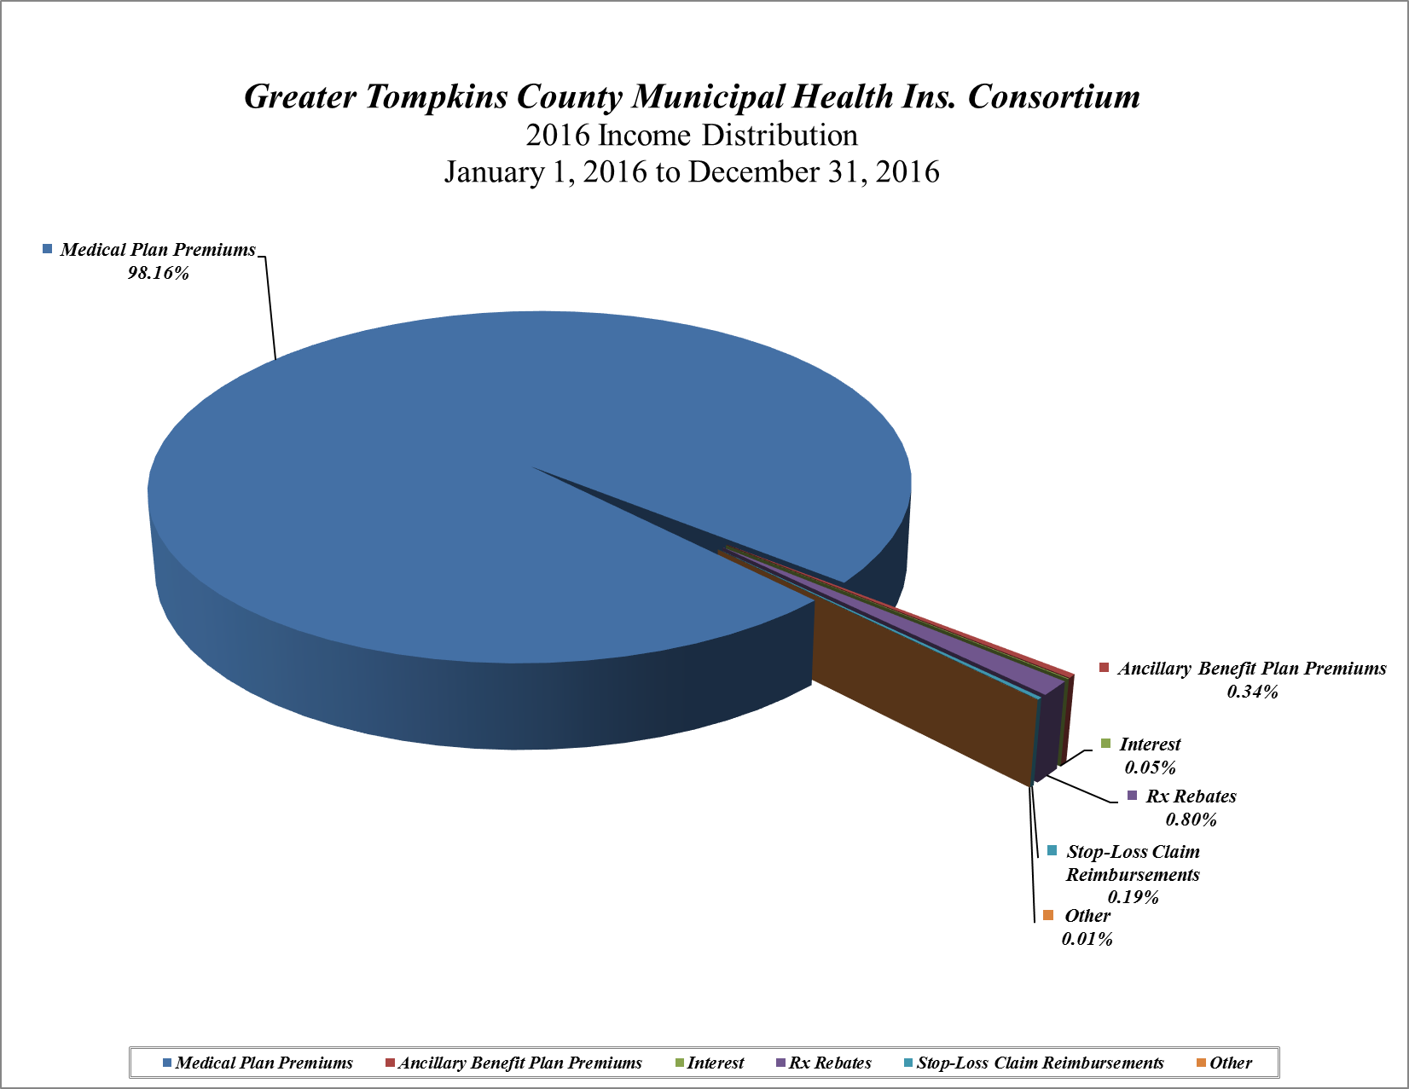

Slide 30
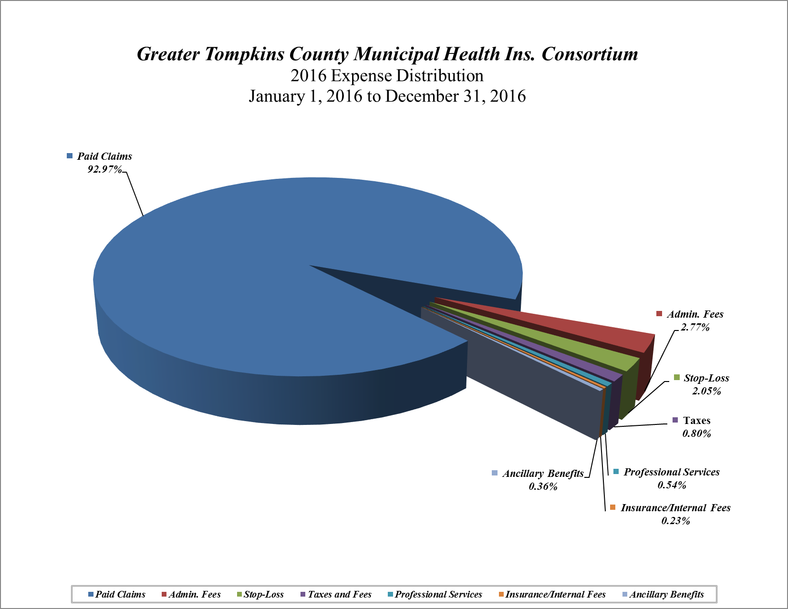

Slide 31
Stop-Loss Insurance
Article 47 Require the Purchase of Stop-Loss Insurance
Aggregate Stop-Loss Insurance- (just waived by DFS)
Annual Cost (now savings) ≈ $70,000
Specific Stop-Loss Insurance
Protects the GTCMHIC from financial harm caused by a single catastrophic large loss case.
2018 Annual Per Person Deductible = $600,000 (2017= $450,000)
Coverage Maximum Per Person = Unlimited
2018 Annual Cost ≈ $450,000 (2017= $744,000)

Slide 32
What are Benefit Plans?
Benefit Plans are a contract between a person and/or their employer and a licensed health insurance company that contains a listing of covered medical care services provided to eligible.
Health insurance companies negotiate “In-network” contract with health care providers for services identified in benefit plan.
Benefit Plans must meet minimum Federal and State requirements.
Notes:
_______________________________________________________________
_______________________________________________________________
_______________________________________________________________
_______________________________________________________________
_______________________________________________________________
_______________________________________________________________
_______________________________________________________________
_______________________________________________________________

Slide 33
What plans are available?
GTCMHIC has a menu of plan options for consideration by labor and management. New plans may be added upon request and approval by the Board of Directors.
Indemnity, PPO, Comprehensive, and Medicare Supplemental plans are available, along with the recently added “metal level” plans that mirror ACA definition of “Platinum, Gold, Silver, and Bronze.”
A variety of plan offerings are necessary to accommodate the needs of Consortium partners and their employees.

Slide 34
Prescription Drug Tiers
Generic Medications (Tier 1)
82% of Prescriptions Filled
Average Cost Per Prescription = $24.61
Brand Name Medications (Tier 2 & 3)
Includes Preferred (Tier 2) and Non-Preferred (Tier3)
18% of Prescriptions Filled
Average Cost Per Prescription = $432.86
Specialty Medications (Tier 3)
1.22% of Prescriptions Filled
34.55% of Overall Prescription Drug Spend
Average Cost Per Prescription = $3,937.62

Slide 35
“ACA Metal Level Plans”
Levels of Coverage:
The Affordable Care Act contains language which defines the Actuarial Value (AV) of a health insurance plan’s coverage based on the percent of health care expenses covered by the plan for the average subscriber. Health insurance plans will be placed into four categories based on their Actuarial Value (AV):
Platinum Plan Models Actuarial Value (AV) = 90%
Gold Plan Models Actuarial Value (AV) = 80%
Silver Plan Models Actuarial Value (AV) = 70%
Bronze Plan Models Actuarial Value (AV) = 60%
It should be noted that these are PPO Style Plans and all but Platinum meet High Deductible Health Plan requirements.
Notes:
_______________________________________________________________
_______________________________________________________________
_______________________________________________________________
_______________________________________________________________
_______________________________________________________________
_______________________________________________________________
_______________________________________________________________
_______________________________________________________________

Slide 36
Actuarial Value Calculator
The term “Actuarial Value” references the share of health care expenses the plan covers for a typical or average group of enrollees within a standard deviation of + or - 2%.
As an example, if enrolled in a Platinum Plan the average person would expect the plan to cover approximately 90% of their health care costs in a given year.
Notes:
_______________________________________________________________
_______________________________________________________________
_______________________________________________________________
_______________________________________________________________
_______________________________________________________________
_______________________________________________________________
_______________________________________________________________
_______________________________________________________________

Slide 37
Maintaining a Plan’s AV
The GTCMHIC established the following process to ensure the Standard Metal Level Plans maintain an Actuarial Value (AV) as defined by the Patient Protection and Affordable Care Act (ACA) :
Changes to the benefits provided by the Metal Level Plans will occur no more frequently than once a year with said benefit changes being effective on January 1st of the year following the adoption of the said benefit change.
Changes to the benefits provided by the Metal Level Plans will be approved by the GTCMHIC’s Board of Directors on or before November 1st of each year provided the benefit changes maintain the Actuarial Value of the plan in question as defined in Resolution No. 001-2014.

Slide 38
Maintaining a Plan’s AV (continued)
Changes to the benefits provided by the Metal Level Plans will be communicated to the affected members no later than December 1st of each year.
The GTCMHIC will adhere to the following definition of the Actuarial Value of each plan.
The Greater Tompkins County Municipal Health Insurance Consortium Standard ACA Metal Level Plans will have an Actuarial Value (AV) as defined by the Patient Protection and Affordable Care Act (ACA) equal to an overall plan benefit for the average participant of 90% for the Platinum Plan, 80% for the Gold Plan, 70% for the Silver Plan, and 60% for the Bronze Plan.

Slide 39
How are Changes Made to “GTCMHIC Metal Level” Plans?
AV is Calculated annually
Should AV not be within Standard Deviation Range, Suggested Changes will be Reviewed by the Joint Committee
The Joint Committee may Recommend Changes to the Board
The Board of Directors Approves the Plan Changes
Notifications are sent to Covered Members
Changes are Coordinated with Excellus and ProAct
Plan Changes Effective January 1st Following Approval

Slide 40
Tonight’s Board Agenda
Wellness Consultant RFP
Executive Committee
Financial Report -2018 ytd; 2017 Annual Statement (JURAT)
Stop-Loss Insurance
Catastrophic Claims Reserve
Online Enrollment Policy
Investment Policy

